Slide 1


Theory +Economic Survey Vol.2 + Vol.1 + Budget 2016
1.Banking Finance
6.HRD
2.Budget-Fiscal Policy
3.BoP
4.Sectors of Economy
5.Infra
V2C2-Pub.Fin; V1C3-JAM
V2C3-Monetary mgmt+FI
V2C4-External sector
V2C5-Price,Agri.; V2C6,7
V2C8-Paris Summit, Energy
V2C9-Social infra.
V1C4-Agri ; V1C9-Fertilizer
V1C5-mother-child
V1C6-bounties; V1C7-Fiscal Cap
V1C8-PTA
V1C2-Chakravy; V1C10-Labour
V1C11-Powering 1 India
B1. Financial Sector Reforms
B2. Fiscal Discipline
B3. Tax Reforms; B4. Ease of
B5. Agro: 2x farmer income
B6. Rural infra-employment
B7. Infrastructure
B8. Social Sector & healthcare
B9. Education, Skills, Jobs
V2C1- Chakravyuh challenge
V1C1- Twin Balancesheet
Mostly done; not much on “finance” except merger of SEBI-FMC; remainder of ECB-under BoP; Startup/Infra finance-separate pillars and so on
+Survey Ch.1s Spread throughout; SDG-Goal esp. @#4,5,6; HDI Report@6

Slide 2
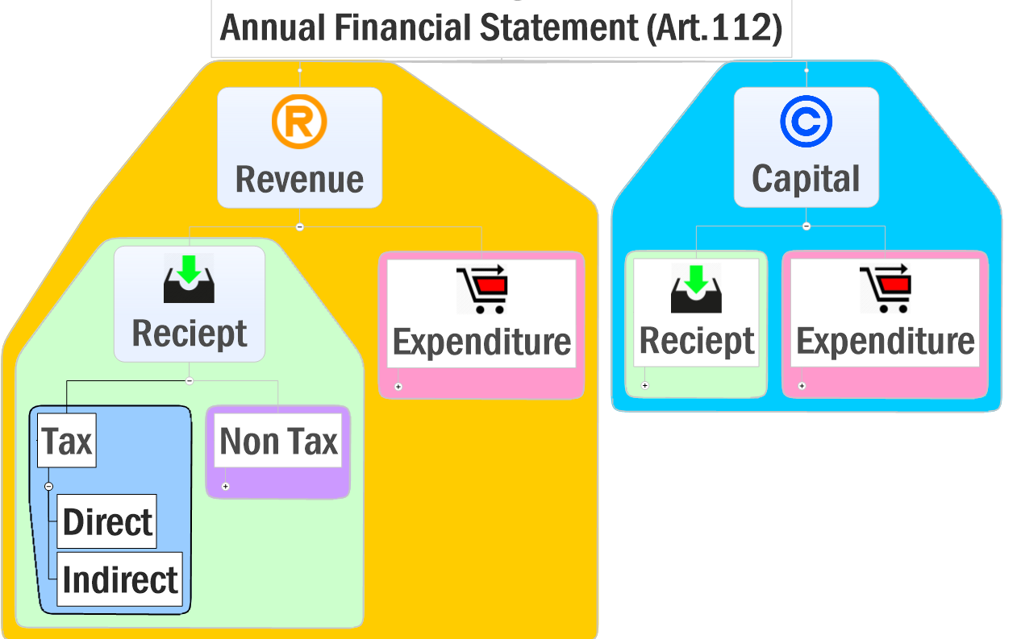
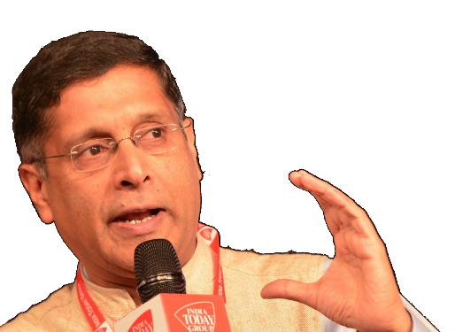
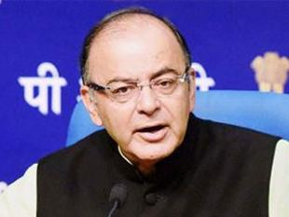
TODAY: Budget ►Revenue Part
▲Fiscal capacity, why & how?
▼Tax avoidance, evasion & litigation. How?
1 Lakh Cr. Subsidies going to rich, but We can’t JAM-DBT everything because….?

Slide 3
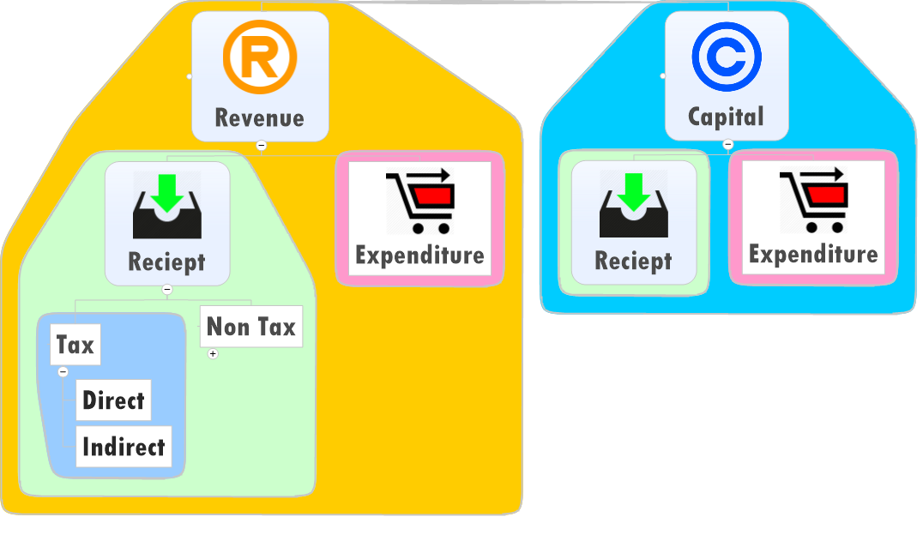

Budget ► Revenue ► Receipt ► Tax
1st listen to me…
Vol1-07-fiscal Capacity For The 21st Century
Vol2-02-public Finance
Fiscal Capacity: Ability of the government to generate revenue from households and industries.

Slide 4
Democracy as a contract
State
Essential Public services: Police, Judiciary, Health, Edu, Defense
Citizen
Election
Taxation / user-fees
Conscription: Compulsory Military service
Re-distribution of wealth/resources through taxation and public spending
Fundamental Duties

Slide 5

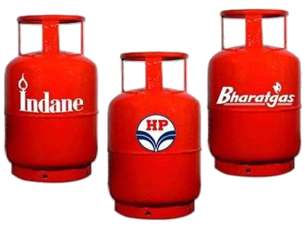
Taxation: Two way accountability relationship
Govt. . . ►Democratic contract ◄. . Citizens
Government
But when Government focuses more on wealth re-distribution.. Upper Middle & Rich Class will
Re-Distribution of Wealth Essential services
Free-rider
Not giving up LPG subsidy even If >10 lakh income
Exit
Pvt.School, Hospitals Diesel Generators Tax avoidance, Evasion
Accountability
Fiscal Capacity
▼▼
Notes:
Citizen's part of the contract is to hold the state accountable when it fails to honor the contract.
A citizen's stake in exercising accountability diminishes if he does not pay in a visible and direct way for the services the state commits to providing.
If a citizen does not pay - through taxes or user fees - he either becomes a free rider (using the service without paying) or exits (not using the service at all).
Both reduce the accountability of the state.
Hence the expression: no representation without taxation.
Taxation is not just about financing public spending, it is the economic glue that binds citizens to the state in a necessary two- way relationship.
A corollary is that if the state's role is predominantly redistribution, the middle class will seek - to exit from the state. They will avoid or minimise paying taxes;
they will cocoon themselves in gated communities;
they will use diesel generators to obtain power;
they will go to private hospitals and send their children to private education institutions.
All these pathologies are evident in India.
By reducing the pressure on the state, middle class exit will shrink it, eroding its legitimacy further, leading to more exit and so on
A state that prioritises or over-emphasises redistribution without providing basic public goods, risks unleashing this vicious spiral

Slide 6

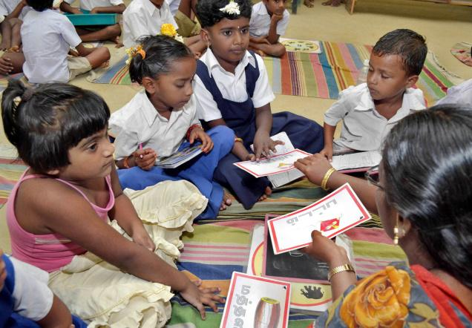
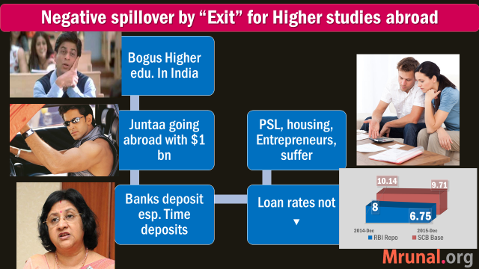
How Middle Class “Exit”: ▼ accountability & service quality
Erode Collector R. Anandakumar admitted daughter in Government school

Slide 7
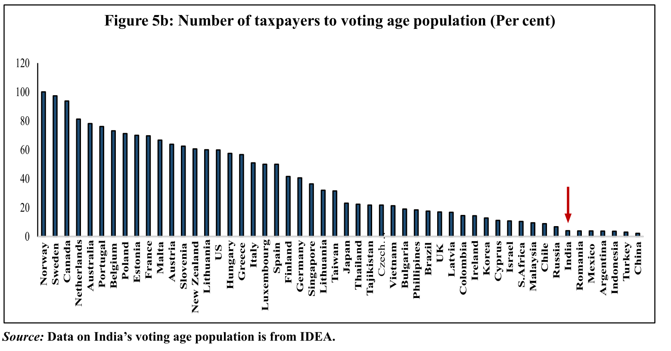

“Exit” : ~4% of Indian Voters are Tax payers (ideal 23%)
Norway, Sweden= High HDI

Slide 8
#Tax Payers= key indicator of Fiscal Capacity
~4% of voters
5.5% of earning individuals
~85% of economy outside Direct tax net
These numbers are bad given India Eco. Pol. Development

Slide 9
Consequences of ▼ Fiscal Capacity
Can organize mega events without terror attacks
But can’t ensure women safety on daily basis

Slide 10
Consequences of ▼ Fiscal Capacity
Can rise from Earthquake & Tsunami
But can’t rise from Malnutrition & Famines

Slide 11
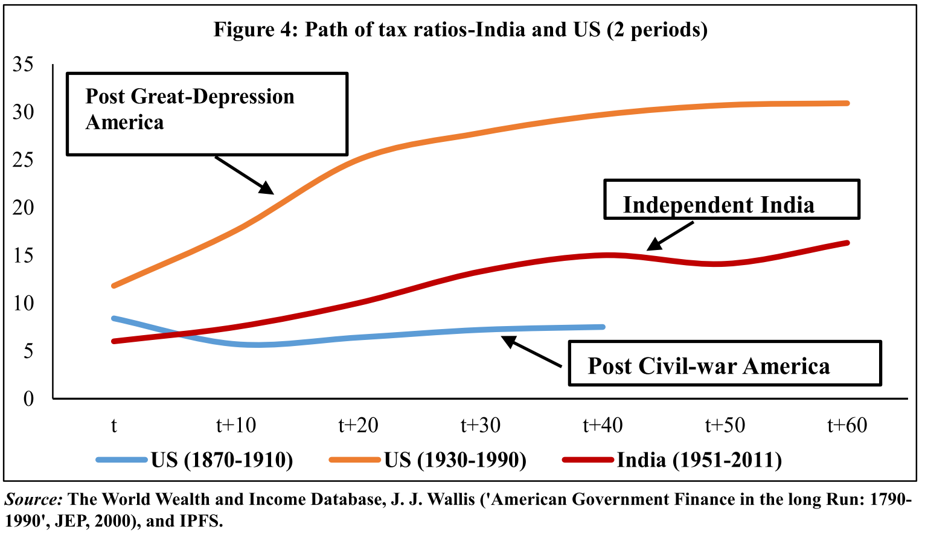

Fiscal Capacity: Ability of the government to generate revenue from households and industries.
Only 4% Indian Voters are tax payers

Slide 12
Democracies of World-US: Oldest, India: Largest
States first roll-out public services, then begin taxations to gain legitimacy.
US-UK forced to raise fiscal capacity during Wars, Economic-Depression
India not gone through this path
Notes:
Figure 4 compares the taxation history
of India vis-à-vis that of the US starting
roughly from the year in which taxation
picked-up in the two democracies. For the
US two periods are shown – first, 1870-
1910, the post-civil war period prior to the
introduction of income taxation in 1913;
and second, 1930-1990, after introduction of
income taxation and capturing the boost to
fiscal capacity brought about by the Second
World War. These two periods are contrasted
to taxation experience of independent India
starting 1951. It is clear that even though
India (middle line) has lagged behind the
US in having a lower tax to GDP ratio when
compared to the second period in US (1930-
1990), India has done better than the US did
in the initial stage (1870-1910).
7.24 Moreover, western democracies
have had a much longer period of political
evolution allowing them to build state
capacity. This is important in assessing India’s
fiscal performance as highlighted by Professor
Indira Rajaraman 7 .
7.25 The history of Europe and the US
suggests that typically, states first provide
essential services (physical security, health,
education, infrastructure, etc.) before they take
on their redistribution role. That sequencing
is not accidental. Unless the middle class in
society perceives that it derives some benefits
from the state, it may be largely unwilling to
finance redistribution.

Slide 13
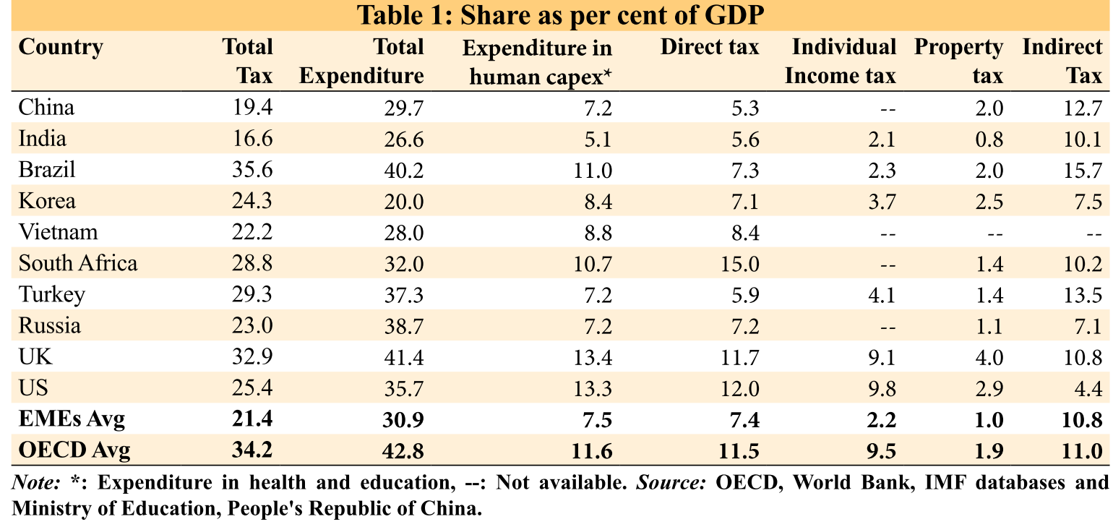
In 1st world: direct tax >> Indirect= more accountable Govt.; Heath-edu Expenditure higher
As such Union DT >indirect;
But union+state combined then
DT>>Indirect
India’s Health-edu. expenditure: GDP low among BRICS

Slide 14
GS2 | GS3
“Taxation is the economic glue that binds citizens to the state in a necessary two- way relationship.” Elaborate

Slide 15
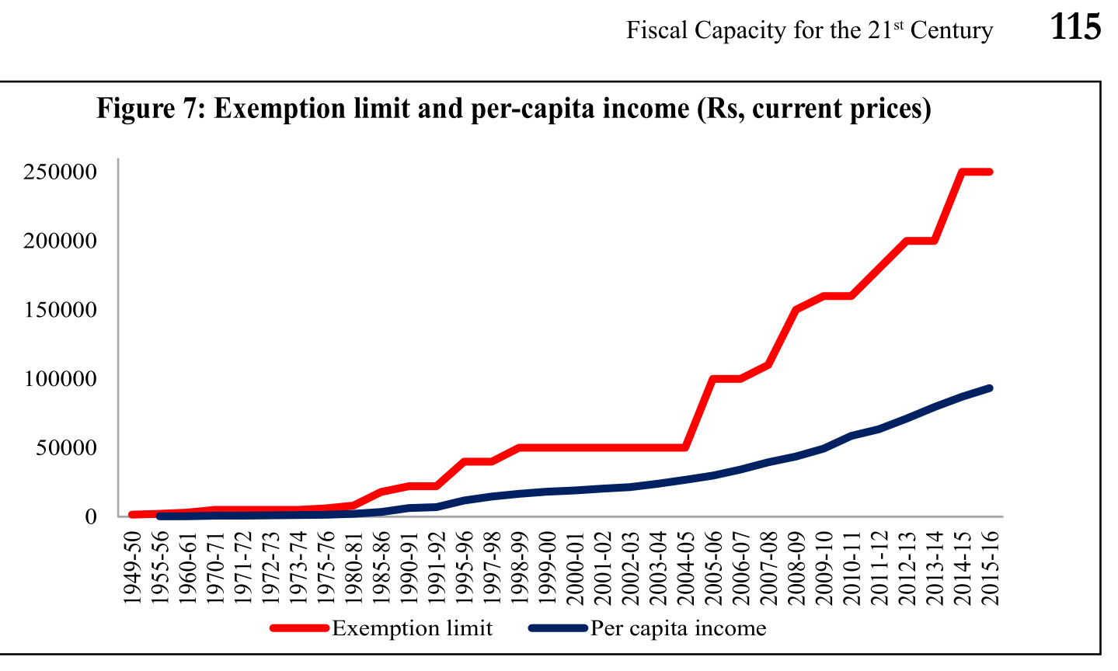
How2 ▲Fiscal Capacity? Reform#1: don’t raise IT ceiling
If threshold kept @Rs.1.5L
1.65 cr. New tax payers
Rs.31,500 cr. Addl.
+0.32% increase in Tax : GDP ratio
Agreed
Budget-2016: Tax slabs unchanged
Missing tax payers
Adam Smith’s canon- ▼ Tax Expenditure by ICT

Slide 16

How2 ▲Fiscal Capacity? Reform#2: Reduce LEAKAGE
Reduce corruption
Panel to streamline manpower
Reduce subsidy to well-off
Tried but fail (EPFO 60% withdrawal)
Reduce exemption/deduction
ICT & less human interface in tax admin.
Fert.DBT (Pilot project in few districts)
Corp.Tax: 30% to 25% in 4 years
Phase wise ▼deductions, exemptions
Agreed
Notes:
▼corruption to gain legitimacy
Reducing subsidy leakages to well-off (Rs.>1 lakh cr.)
Reducing tax exemptions/benefits to corporates (under process: Corp.Tax to be reduced from 30% to 25%; wide range of exemptions to be phased out)

Slide 17
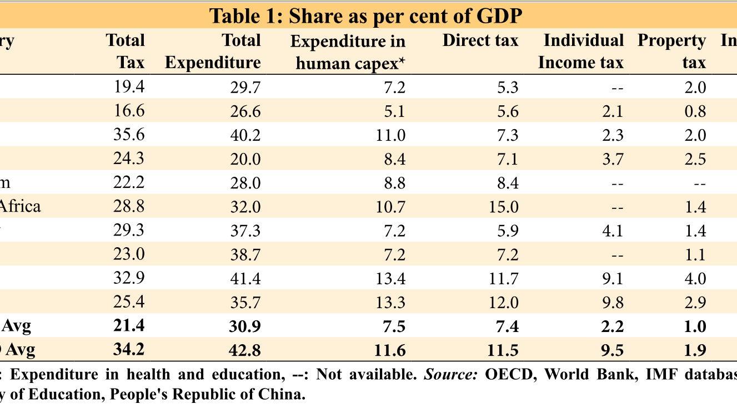
How2 ▲Fiscal Capacity? Reform#3: Build property tax regime
Benefits: Progressive
Difficult to evade (non-mobile good)
▲ Tax rates= sand in the wheels of property speculation. (NHB Housing index)
▲Local finance =Urban infra.
Budget-2016: nothing special in this direction but tax benefits to buyers and builders to promote affordable housing for all.
Notes:
and buoyant
95 per cent of filings are electronic
tax refunds are now being issued in 7-8 days
other countries indicates that India under- taxes and under-spends.

Slide 18
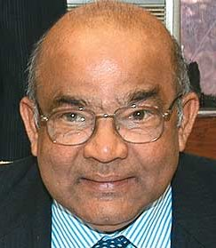

Property Tax to augment PRI
14th FC
Increase property tax as per inflation & Development
Assessment every 4-5 years.
Stringent action on evasion
Yes, I agree.
If State/PRI ▲ revenue through property tax
Then less pressure on union finances.
14TH FC self-study “L4/P7”

Slide 19
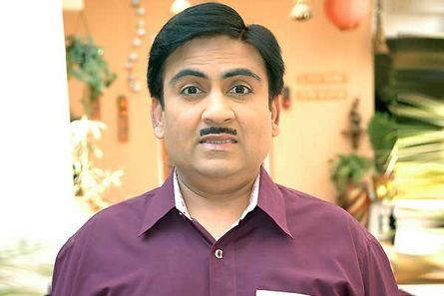
GST introduction
Fiscal capacity
Economic Survey-2015
GST = beneficial; but citizens don’t feel pinch like direct taxes
hence GST= limited impact on strengthening democratic accountability, unlike Direct Taxes
Moody’s report: 2016, Apr
GST = uphill task since Government doesn’t have Rajya Sabha majority
Fir bhi, GST self-study “L4/P8”

Slide 20
On Tax administration reform commission recommendation
TPRU
disseminate policy papers
Assist Tax Policy Council chaired by FM
Liaise with State Commercial Tax Departments.
The Revenue Secretary will supervise
CBDT and CBEC will give them fiscal/tax topics to do research.
Tax policy research unit
TPC
Tax policy council
Follow-up on reports of Tax Policy Research (TPRU) Unit
suggest broad policy measures for taxation.
The Council will be advisory in nature.
Functions

Slide 21
On Tax administration reform commission recommendation
TPRU-Research
Boss: Chief commissioner of CBDT/CBEC (fixed and alternate tenure). Final reporting to revenue secy.
Tax policy council
Other CBEC and CBDT officers
economists, statisticians, operational researchers, legal experts.
Finance minister and MoS
Chief eco. advisor
Niti Ayog Dy.Chairman
Secretaries from Finmin, DIPP etc.
+Special invitees: CBEC and CBDT Chairman
Membership

Slide 22



In February 2016
Most Some suggestions accepted
Democracy=contract, Taxation=glue
#1: don’t raise slabs….accepted
#2: stop leakage…partially accepted; EPFO#EPICFAIL
#3: property tax regime: union wealth tax
#4: GST enforce accountability
+ TARC’s two bodies
Things are easier said than done.

Slide 23
Need to augment fiscal capacity
No, 1st listen to me…
Vol1-07-fiscal Capacity For The 21st Century

Slide 24
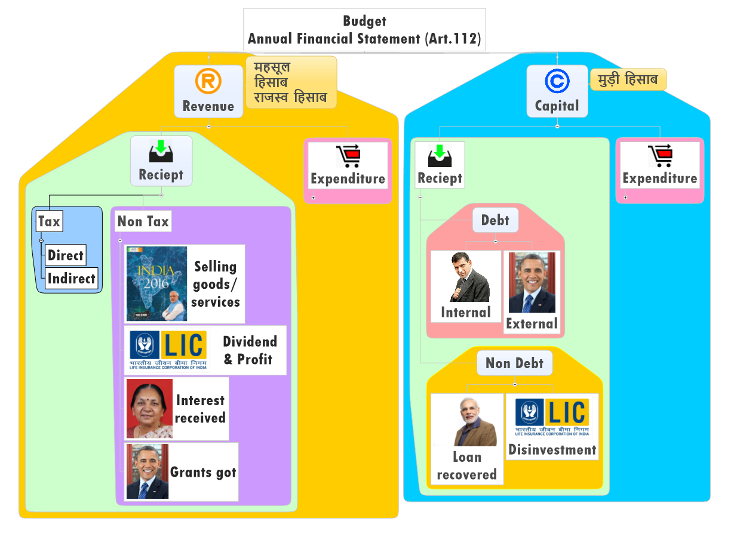

Where is consolidated fund? Art. 266
CFI has:
Incoming Revenue
Loans raised
Loans recovered
Whatever else parliament may provide
Withdrawal need Parliament Permission (- Charged Expenditure)
Surcharge
Swatch Bharat Cess
Krishi Kalyan Cess
Clean Energy Cess
Notes:
Because parliament by law provide, and finance bills put them under CFI rather Public accounts

Slide 25
Charged items on consolidated fund of each…
Union
Constitutional posts, office maintenance
State
UT
Administrator, Judicial commissioner
Debt charges / loan repayment/interest, $ required to satisfy court judgement/decree
SC: salary, allowance, Pensions
Similar to above
Speaker, Dy. In both houses- Salary, allowance
Any other item declared by parliament
+ similar to above
Charged items
Can be discussed
Can’t be voted
In Goa, Diu & Daman- ‘63
Highest civil & criminal court;
Appeal►Bombay HC ►SC

Slide 26
Where is Public Account? Art. 266
Provident fund, post office deposits
Edu Cess: Prarambhik Shiksha Kosh (HRD, Nonlapse) SSA+MDM
National investment Fund

Slide 27
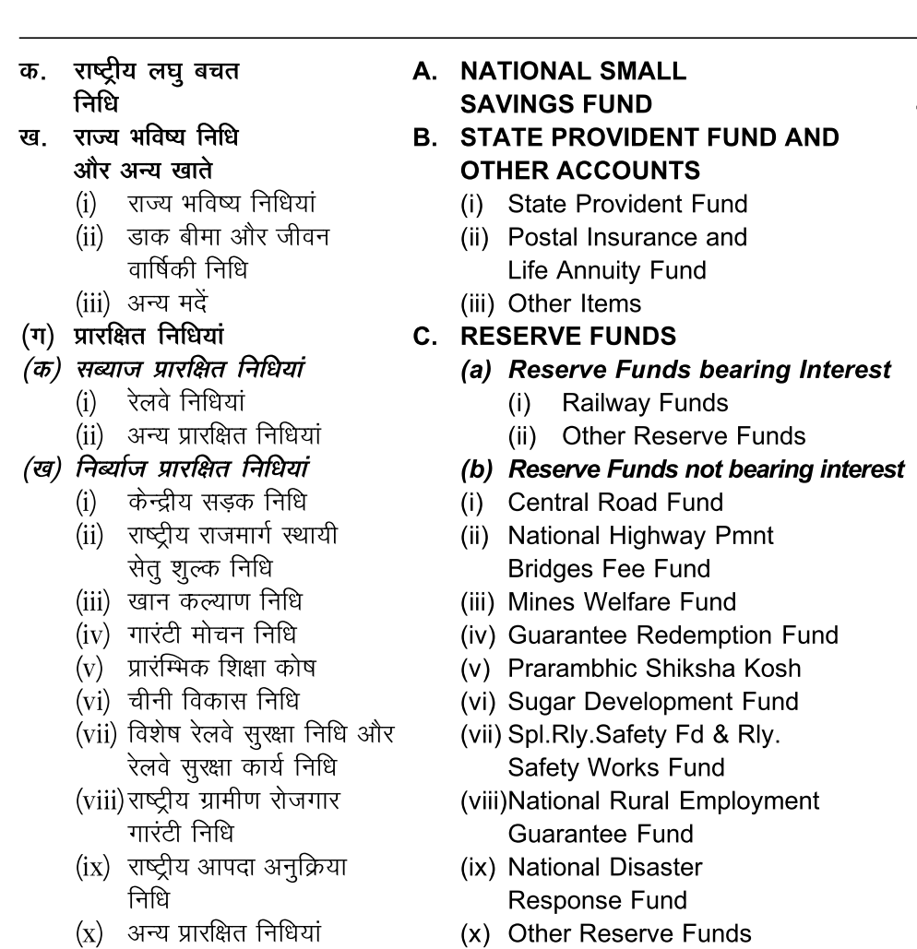
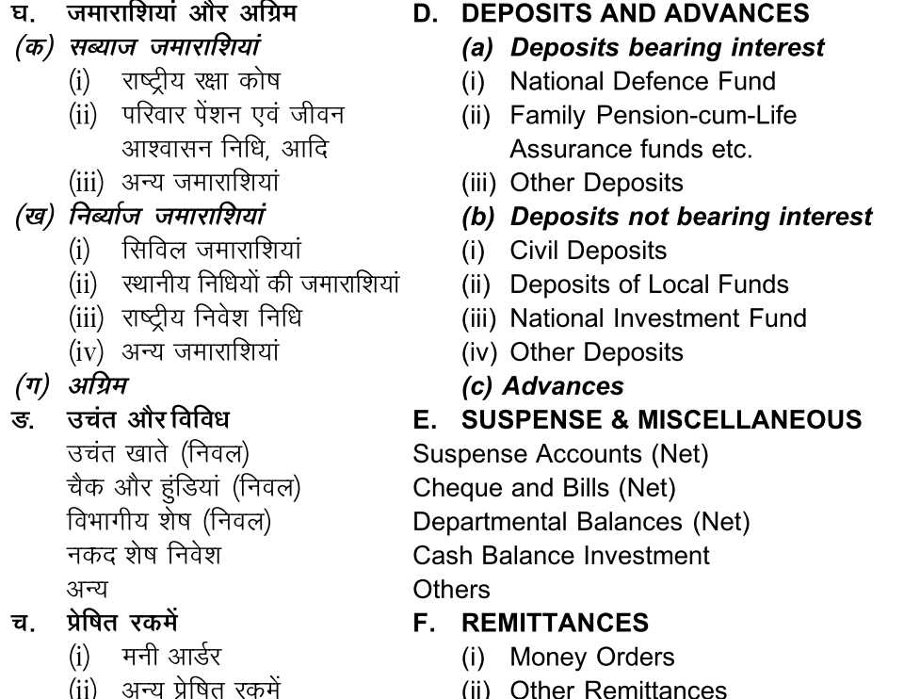
Public account: components of..

Slide 28
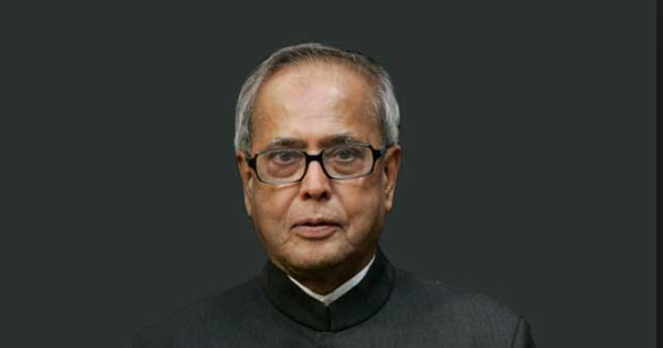
Consolidated Fund-266
Incoming Revenue, loans raised, loans recovered
Public Account-266
Contingency Fund-267
Unforeseen events Rs.500 cr.
Withdrawal need Parliament Permission (- Charged Expenditure)
President /FinSecy
Parliament approval “subsequently” obtained, after Expenditure (IYB-2016, 343)
Govt. acts as banker: Incoming provident, small savings, postal deposit etc.
IF separate fund for specific expenditure need parliament permission-IYB-2016,343 e.g. road, mid-day meals
Refilling needs parliament permission

Slide 29

But where is Controller General of Accounts ?
fin.min
Economic Affairs
Expenditure
Revenue
Financial services
Disinvestment Investment & Public Asset Management
Budget►
Survey►CSO,CEA,Finsec,FM
ICAS via UPSC-CSE
[IYB-2016 Page 387]
I also “play” for the country!
Renamed in Budget 2016

Slide 30
Why Appropriation Bill by CGA ► FinMin?
114/3: To withdraw the passed money by Lok Sabha
266: no money out of CFI without law
Demand of Grants
Only with President recommendation: 113/3
Charged Expenditure
Voting nope (113/1)
Loksabha can approve, reject, reduce: 113/2
Discussion yes, possible in both houses
Separate for Ministries, States &UT, UT w.o.Legislature
Estimated Expenditure from Consolidated fund
Consolidated Fund-266
Contingency Fund-267
Public Account-266

Slide 31
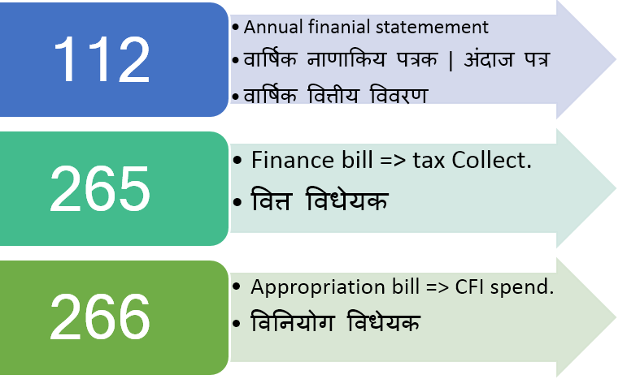
Why 3 documents?
Budget

Slide 32
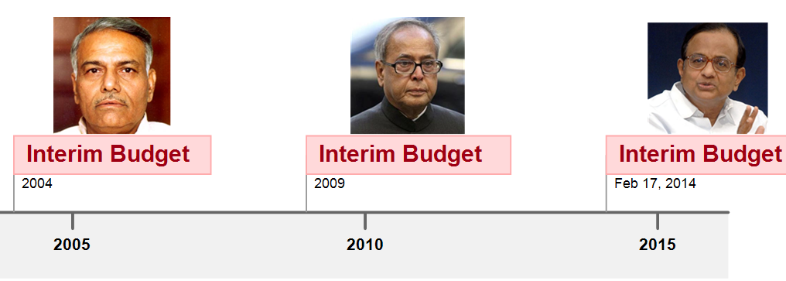
What’s the difference?
Vote on Account
Every year for cash problem between Feb to April when budget is passed
Interim Budget
Only Appropriation Expenditure permission
Election /extreme situation when immoral for outgoing Government to make drastic changes.
Valid: 2-4 months
All 3 docx + vote on account
Valid-whole year, unless changed by new govt.

Slide 33
Where is consolidated fund? Art. 266

Slide 34
Where is consolidated fund? Art. 266

Slide 35
Budget ► Revenue ► Receipt ► Tax

Slide 36

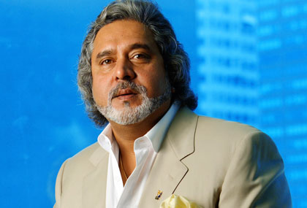


Direct taxes of Union: Yellow = Gone
On Expenditure
Fringe Benefit (Pranab)
On Assets, Property, Capital transactions
Income tax;
Interest tax (on banks)
Hotel receipt Tax
STT;CTT
Wealth Tax (Jaitley)
Banking Cash transaction tax
Estate Duty (VP Singh)
Gift Tax (Yashwant)
On Income
DDT @Co.
CGT @Buyer
Corp. Tax & MAT

Slide 37
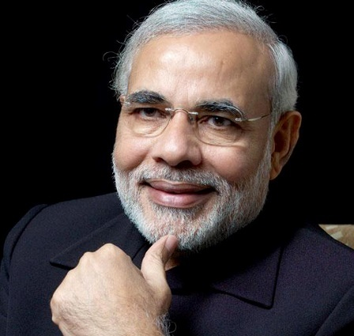
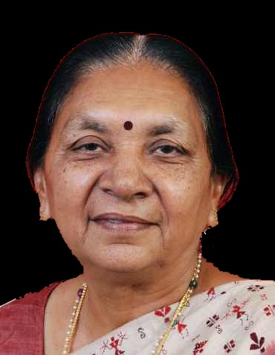
Direct Taxes in India
Union
On Expenditure
Fringe Benefit Tax (Pranab)
On Assets, Property, Capital transactions
Income tax; Corp.Tax ; DDT; MAT;CGT
Interest tax (on banks)
Hotel receipt Tax
STT;CTT
Wealth Tax (Jaitley)
Banking Cash transaction tax
Estate Duty (VP Singh)
Gift Tax (Yashwant)
On Income
States
Agriculture income tax
Professional tax Art.276: state/LocalG. (Max 2500. 14th says raise to 12k)
On property
Land Revenue
Stamp/registration duty
Property tax in urban areas (survey: strengthen)
On Income

Slide 38
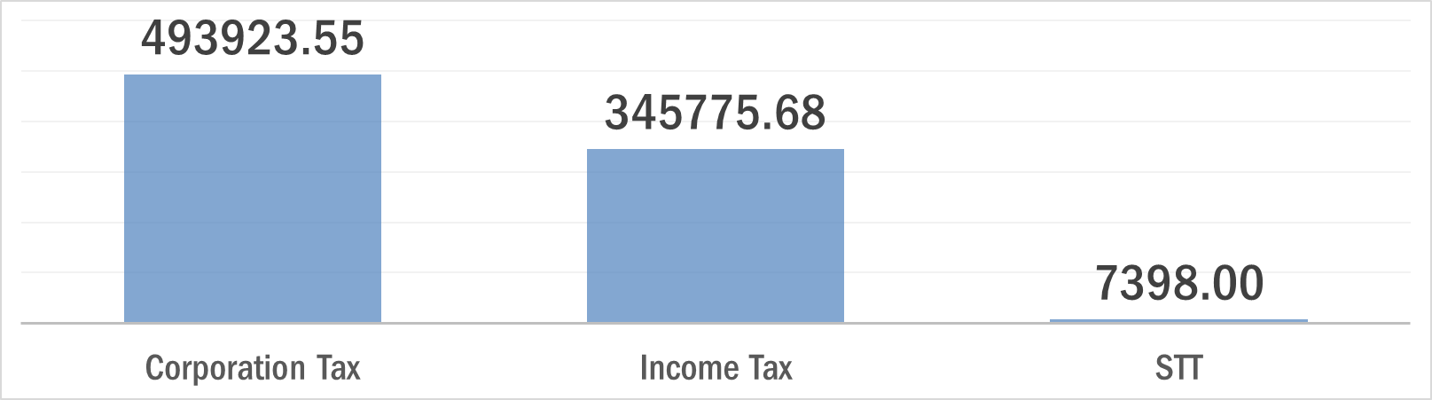
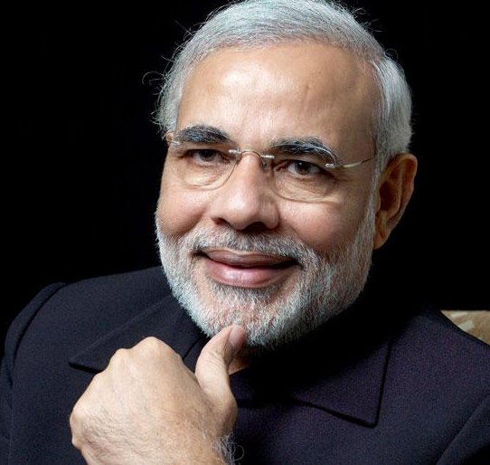
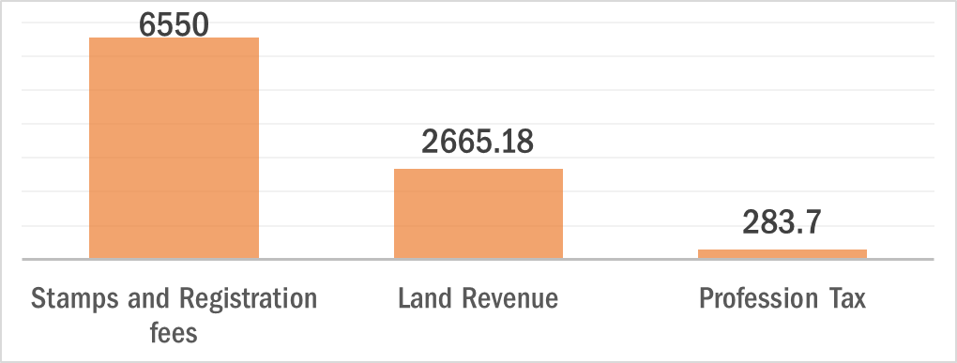
Budget 2016: Direct taxes

Slide 39
Direct Tax
Merits
Progressive (richer person higher tax)
Demerits
Collection expensive (staff salary, database Management).
Inequality of income …reduced
Certainty (when and how)
Elasticity, quick results when raised / lowered.
Therefore, Narrow base.
Externality not counted: Tata vs filmstar
Hardship not counted: Carpenter vs landlord.
High level of direct tax► laziness, less foreign investment
To encourage Savings & investment: tax deduction- exemptions given► litigation, avoidance using loopholes

Slide 40
Indirect Taxes
Union
Custom
Excise
Service
CST
State
VAT-Newspaper
Excise on liquor, narcotics
Vehicle, animal, boats, tolls
Luxury, betting-gambling
Advertizement-TV,Radio,Newspaper
Entertainment, electricity
Which of these will be subsumed in GST?
See past video

Slide 41
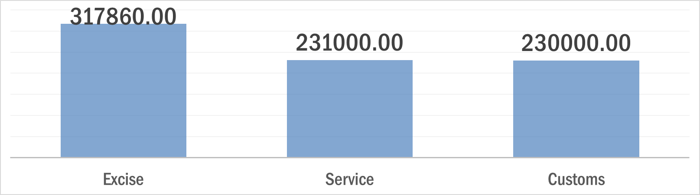
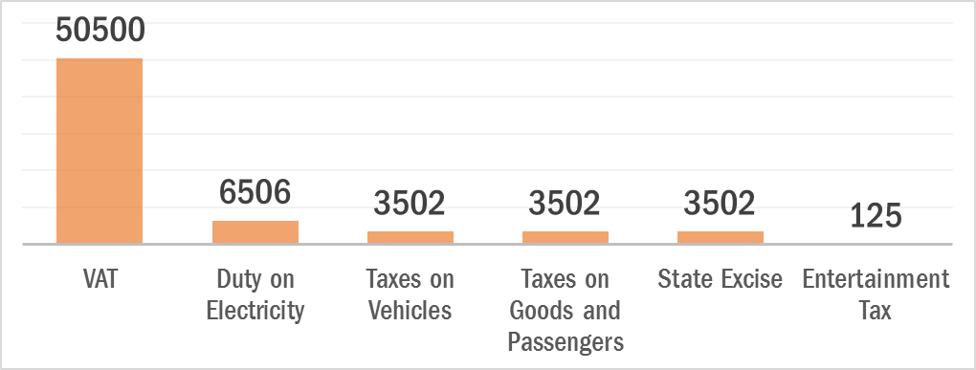
Budget 2016: Indirect tax
transport

Slide 42
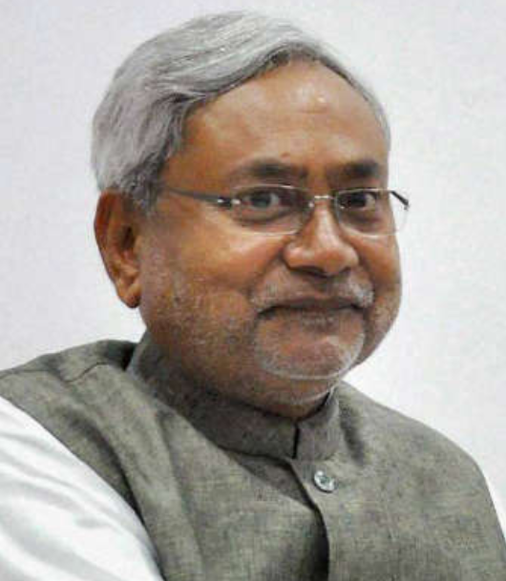
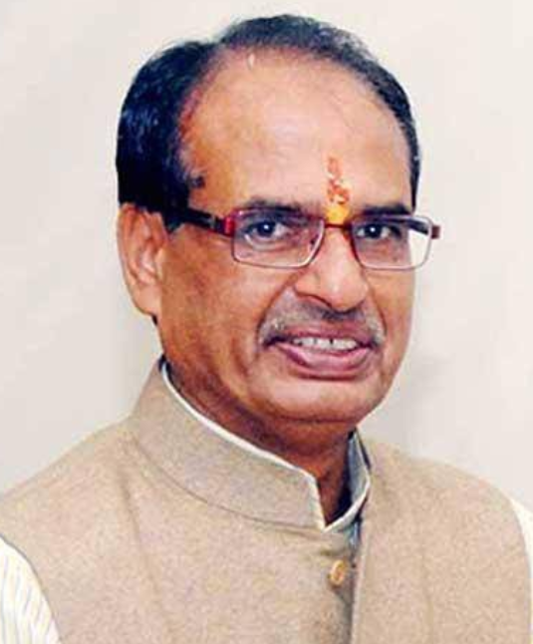
State Excise (Rs.cr)
Prohibition
Liquor, Narcotics
Notes:
Bhang tax ~100 per kg.
http://finance.bih.nic.in/Budget/Annual-Financial-Statement.pdf
http://www.finance.mp.gov.in/2016/volume1.pdf

Slide 43

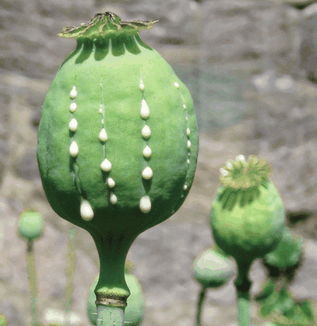
Opium (अफ़ीम)
Morphine
Codeine
Thebaine
Heroin (Smack)
Cannabis (भांग)
Hashish
Charas
Ganja
Marijuana
Cultivation Forbidden in India- NDPS Act
Permitted in
Rajasthan, MP,UP

Slide 44
Indirect Tax
Merits
Convenient. no additional paperwork for the customer.
Wider base. Everyone covered.
Less evasion, especially under VAT/GST. (invoice credit)
Elastic. Small increase brings large revenue
Checks on harmful consumption: cigar, alcohol, even GOLD.
Demerits
Single point taxes=high level of corruption, evasion, cascading effect. E.g. sales tax. (Although not in GST/VAT)
Regressive in nature
Both poor and rich taxed equally for the same item
poor people end up paying more portion of their income in indirect taxes.

Slide 45



Budget-2016 ► Revenue Receipt ► Tax Revenue
Union- can levy excise on alcohol- in medicinal and toiletry preparation
Descending order
Taxes on income other than Corporation Tax

Slide 46
Budget 2015 vs. 2016: Revenue-Estimates (cr.)

Slide 47
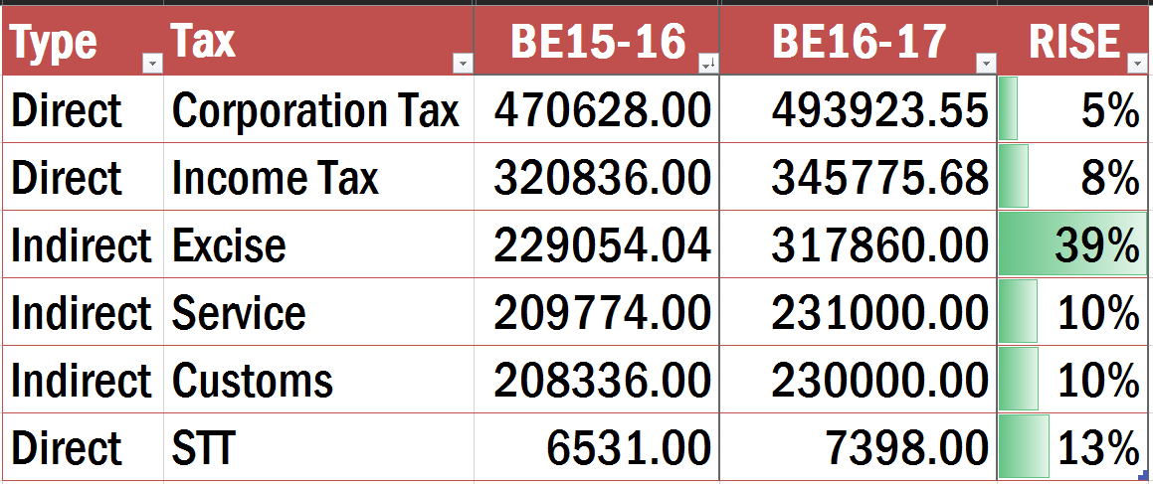
Budget 2015 vs. 2016: Revenue-Estimates (cr.)
Tax benefit
Make in India

Slide 48
Revenue shortfall

Slide 49
Budget 2015 (projected estimates in beginning)
Taxes on income other than Corp.Tax

Slide 50
Budget 2015 vs. Revised estimates
Taxes on income other than Corp.Tax

Slide 51
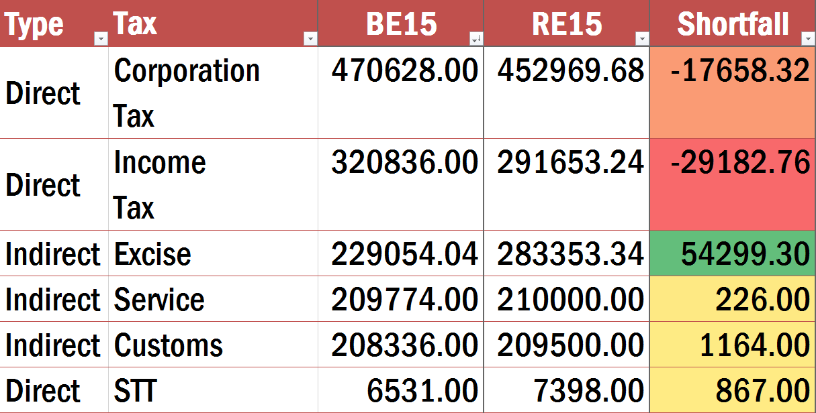
Revenue shortfall?
Fall in crude oil prices, but Government kept increasing excise

Slide 52
Mock question
Budget 2016
During the financial year 2015-16, revenue shortfall was not observed in which of the following taxes?
Corporation tax
Income tax
Excise duty
None of above.
Right answer

Slide 53
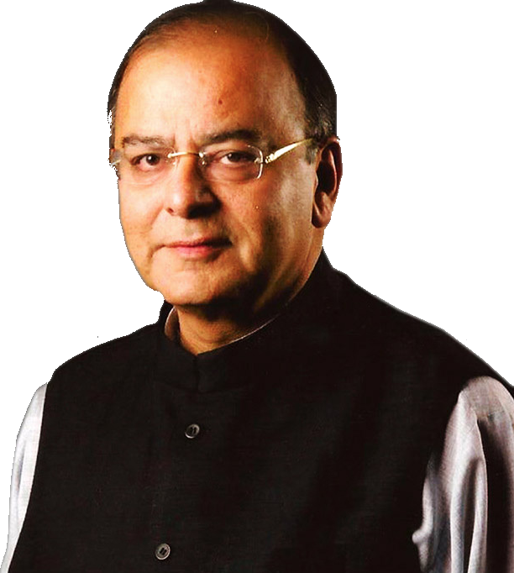
Budget 2016: Revenue Receipts►Tax►Direct Taxes
On Expenditure
Fringe Benefit (Pranab)
On Assets, Property, Capital transactions
Income tax;
Interest tax (on banks)
Hotel receipt Tax
STT;CTT
Wealth Tax (Jaitley)
Banking Cash transaction tax
Estate Duty (VP Singh)
Gift Tax (Yashwant)
On Income
DDT @Co.
CGT @Buyer
Corp. Tax & MAT

Slide 54
Budget-2016: individual income Tax slabs *NOT* RAISED
Income slab |  |  | Very senior (80/>)
Upto five lakh |  |  | NA
>5-10 |  |  | 20%
>10 |  |  | 30%
>1 Cr. | 30% tax + 12%15% surcharge on that tax

Slide 55
Budget-2016: individual income Tax slabs *NOT* RAISED
Income slab |  | Senior city (60 to <80) | Very senior (80/>)
Upto 3 lakh |  | NA | NA
>3-5 lakh |  | 10%
>5-10 |  | 20% | 20%
>10 |  | 30% | 30%
>1 Cr. | 30% tax + 12%15% surcharge on that tax

Slide 56
Budget-2016: individual income Tax slabs *NOT* RAISED
Income slab | General | Senior city (60 to <80) | Very senior (80/>)
Upto 2.5 lakh | NA | NA | NA
>2.5-3lakh | 10%
>3-5 lakh |  | 10%
>5-10 | 20% | 20% | 20%
>10 | 30% | 30% | 30%
>1 Cr. | 30% tax + 12%15% surcharge on that tax
Rs.5,000 rebate if taxable income upto 5 lakh
3% edu. Cess on ALL: (Tax + Surcharge)

Slide 57
Relief to small tax payers
Gross income
Minus Deduction, Depreciation, Exemptions
House rent: 24,000 60,000
Taxable income
10% (upto Rs.5 lakh)
MINUS Rebate 2000 Rs.5000
1st Home buyer: Loan interest deduction 2L 2.5L*
Cess, Surcharge on this.
EPF controversy► “labor reforms & Social security”
Notes:
Provided home loan 35l for max 50 la house.
Budget 2015
100% deduction on
Swatch Bharat Kosh (FinMin)
Clean Ganga Fund (FM Trust)
National Fund for control of Drug Abuse (FinMin)
The people who do not have any house of their own and also do not get any house rent allowance from any employer today get a deduction of `24,000 per annum from their income to compensate them for the rent they pay. I propose to increase the limit of deduction in respect of rent paid under section 80GG from `24,000 per annum to `60,000 per annum, which should provide relief to those who live in rented houses.

Slide 58
Taxable income is 3 lakh rupees.
IT: 30,000
Minus 5,000 Rebate
(earlier 2000)
IT: 25,000
=3% Cess on (Tax+Surcharge) 3% of 25k
Surcharge NA
(15% on >1cr.)
IT: 25k Surcharge: N/A Edu.Cess: 750
Cess: 2% primary &
1% secondary & Higher edu.

Slide 59
Taxable income in crores of rupees
IT: 20,00,000
Minus 5,000 Rebate NA
IT: 20,00,000
3% Edu. Cess (Tax+Surcharge) 3% of (23L)
Surcharge: 15% =3,00,000
Final: IT: 20L Surcharge:3L Cess: 69000
Edu Cess: Prarambhik Shiksha Kosh, Public Account, Specific purpose , FC can’t share
Goes to CFI, no specific purpose FC can’t share

Slide 60
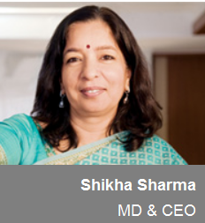
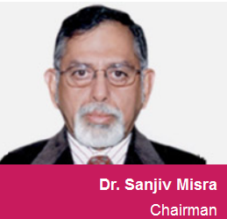


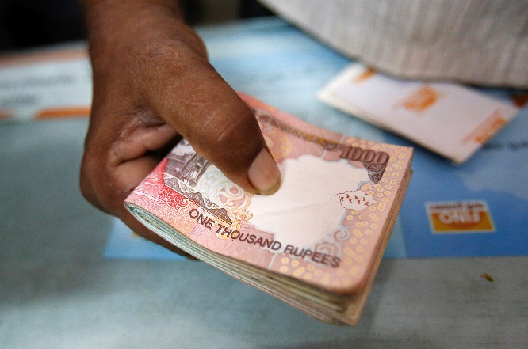

Fairness in DDT
Budget 2016
PROFIT
Board of Directors
DIVIDEND-10% DDT(@source)
SHARE-HOLDERS
If >Rs.10 lakh dividend, addl.10% Tax (@destination)
To ensure fairness & progressive nature of direct tax
Notes:
Dividend has to be distributed acc. To shareholding
How can Biyani make more than his share holding? Ans. Royalties!

Slide 61

Direct taxes of Union: Yellow = Gone
On Expenditure
Fringe Benefit (Pranab)
On Assets, Property, Capital transactions
Income tax;
Interest tax (on banks)
Hotel receipt Tax
STT;CTT
Wealth Tax (Jaitley)
Banking Cash transaction tax
Estate Duty (VP Singh)
Gift Tax (Yashwant)
On Income
DDT @Co.
CGT @Buyer
Corp. Tax & MAT

Slide 62
In next 4 years, Corp.Tax to be 25% phase wise
Tax
30%
Category
Desi Co.
Foreign Co.
Local Authority, Cooperative society, partnership, LLP >1 cr.
25%: MFG After 1/4/16 29%: Turnover upto 5 cr. 30%: others
40%
If they don’t claim acc.depreciation, deductions**
Notes:
http://www.incometaxindia.gov.in/charts%20%20tables/tax%20rates.htm

Slide 63
In next 4 years, Corp.Tax to be 25% phase wise
Tax
30%
Surcharge
12%
7% (>1cr-<10cr.) 12% (>10cr.)
Category
Desi Co.
Foreign Co.
Local Authority, Cooperative society, partnership, LLP >1 cr.
25%: MFG After 1/4/16 29%: Turnover upto 5 cr. 30%: others
40%
2% (>1cr-<10cr.) 5% (>10cr.)
If they don’t claim acc.depreciation, deductions**
+3% edu. Cess on (tax + surcharge)
Notes:
http://www.incometaxindia.gov.in/charts%20%20tables/tax%20rates.htm

Slide 64
Corp.Tax
Effective Tax rate (24.67%)
=total revenue / aggregate tax base
Statutory Tax Rate: 30%
Some newspaper
30%+ (12% of 30%) + 3 % (tax & surcharge)
=34.61%
Revenue forgone= tax Expenditure
= Incentives, deduction, tax breaks given ~62k cr.
Not a bad thing. It’s not “tax-waiver”.
Necessary to boost sectors of economy e.g. SEZ, R&D, Automobile, Pension, insurance
Notes:
I had, in my last budget speech mooted the proposal to reduce the rate of Corp.Tax from 30% to 25% over a period, accompanied by rationalization and removal of various tax exemptions and incentives. In any case the effective rate of tax paid by companies comes to an average of 24.67 % because of various exemptions which they are availing of. A phasing out plan of removing these exemptions and tax incentives was placed in public domain and we have received a large number of constructive suggestions.

Slide 65

Phasing out / reducing deductions for companies
Accelerated Depreciation: Max. 40%
In most cases: deduction 150% (by 2017) to 100% (by 2020)
Building Cold chain, warehouse, hospital, affordable housing
Scientific research, infrastructure, SEZ, mineral-Oil production, Skill Development Expenditure, agriculture extension services.
Reduce “Leakage” to Fiscal capacity ▲
Agreed, I’ll do that
Notes:
The accelerated depreciation provided under IT Act will be limited to maximum 40% from 1.4.2017.
The benefit of deductions for Research would be limited to 150% from 1.4.2017 and 100% from 1.4.2020.
The benefit of section 10AA to new SEZ units will be available to those units which commence activity before 31.3.2020.
The weighted deduction under section 35CCD for skill development will continue up to 1.4.2020.
reduction in Corp.Tax rate has to be calibrated with additional revenue expected from the incentives being phased out.

Slide 66
Presumptive taxation
No need to maintain account / audits.
Taxable income (or profit) presumed at
8% of gross turnover. (MSME)
50% of receipts (Professional)
Pay tax on that (surcharge+edu.cess)
No more deduction/depreciation available ***(some caveats)
MSME (non-corporate)
Upto Rs. 1 cr 2 cr
Professional
50 lakh
Notes:
Lawyer, Architect, CA, doctors.
. So, it is on discretion of the business owner to declare that the profit margin in the business is more than the mandatory 8%. If this happens, a higher rate can be adopted to calculate the income derived from the business and tax can be paid accordingly. So, in the above example, a business owner is free to declare income of more than Rs.12 lakh on a total turnover of Rs.1.5 crore.

Slide 67
Start ups
No Capital gains Tax on Startup investors **
10% tax on their royalty income from abroad, if Patented in India
100% deduction of profit for first three years but MAT will apply in such cases.
Budget 2016

Slide 68

Minimum Alternate Tax
MAT
Companies use deduction, exemptions to become “Zero profit companies” & escape tax liability
1987: Rajiv:- Min. Corp.Tax
1996: Chidambaram- MAT
MAT: 18.5%
2015- demanded on Castleton investment (Mauritius)► SC case,
2015: Justice AP Shah recommend no MAT on FII/FPIs.
Notes:
MAT
A.P. Shah Committee and the decision of the Hon’ble Supreme Court in the case of Castleton
provisions of section 115JB of the Income-tax Act so as to provide that Minimum Alternate Tax (MAT) shall not be applicable to a foreign company, w.e.f. 1.04.2001 if the foreign company does not have as a permanent establishment under relevant Double Taxation Avoidance Agreement (DTAA) or a place of business in India.

Slide 69
MAT
As such MAT=18.5% on book profit
No MAT on any foreign company, FII, FPI
WEF 1/4/2001
if they don’t have place of business in India.
Budget 2016

Slide 70
Direct taxes of Union: Yellow = Gone
On Expenditure
Fringe Benefit (Pranab)
On Assets, Property, Capital transactions
Income tax;
Interest tax (on banks)
Hotel receipt Tax
STT;CTT
Wealth Tax (Jaitley)
Banking Cash transaction tax
Estate Duty (VP Singh)
Gift Tax (Yashwant)
On Income
DDT @Co.
CGT @Buyer
Corp. Tax & MAT

Slide 71
CGT is direct tax on “Profit” from sale of asset
1 year for equity-securities
Listed Shares, Bonds, UTI, Equity-MF, 0-coupen bonds
Short term
15%
Long term
20%
3 years for others
e.g. gold, real estate, bonds
Excluded
Personal effects, movable property, Jewelry, Archaeological collection, painting, sculpture, agri-land, gold/defense bonds and allied schemes of 80s and 90s.
3% Edu Cess: yes
Individual: 15% surcharge if >1cr. income
Corporate surcharge: 7%: 1to 10 cr. ; 12% if >10cr.

Slide 72

Budget 2016: Capital Gains Tax (CGT) – exemption
Resident
Non-resident
Rupee denominated bond of Indian company by non-resident-
Sovereign gold bond; gold monetization scheme = ▼CAD
Merger of plans within mutual fund= retail participation
No CGT on profit from currency appreciation.
=deepening of corporate bond market=▼Bank-NPA
No Capital gains Tax on Startup investors **
Notes:
Capital Gains Tax exempt on
Sovereign gold bond; gold monetization scheme
Rupee denominated bond of Indian company by non-resident- if he gains from currency appreciation.
Merger of mutual fund plans

Slide 73
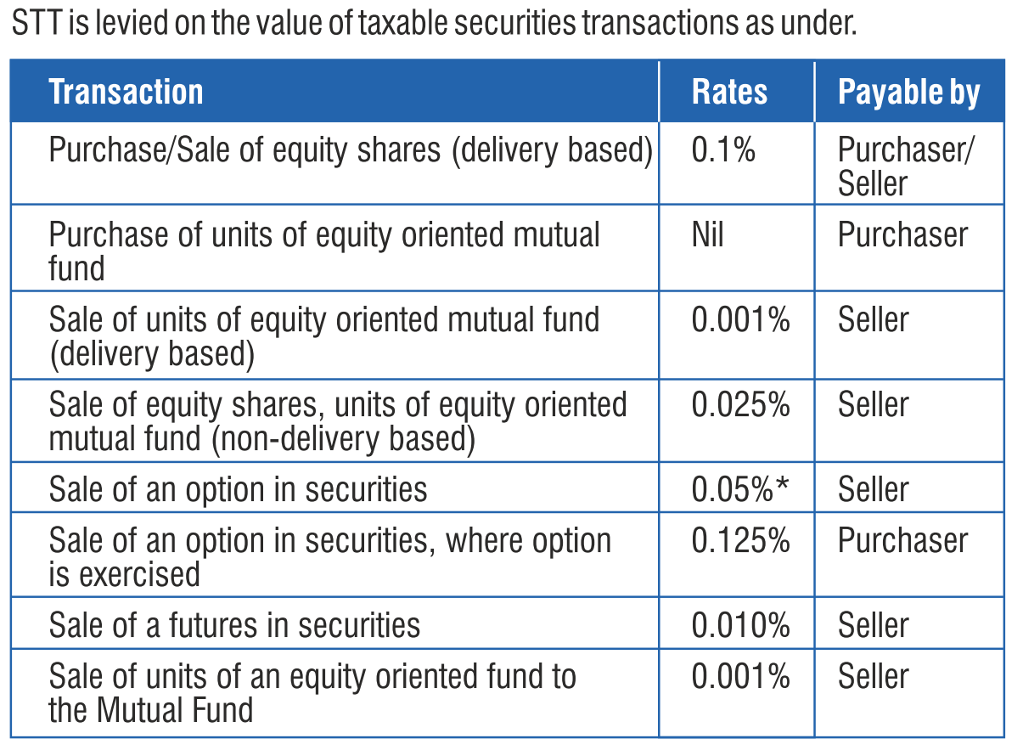
Securities transaction tax (STT): 0.001% to 0.125%
Commodity transaction Tax (CTT)
WEF 2013
Payable by seller
On Exchange traded commodities

Slide 74
Direct taxes of Union: Yellow = Gone
On Expenditure
Fringe Benefit (Pranab)
On Assets, Property, Capital transactions
Income tax;
Interest tax (on banks)
Hotel receipt Tax
STT;CTT
Wealth Tax (Jaitley)
Banking Cash transaction tax
Estate Duty (VP Singh)
Gift Tax (Yashwant)
On Income
DDT @Co.
CGT @Buyer
Corp. Tax & MAT

Slide 75
Budget -2016 ► Revenue Receipt ► Tax ►Direct Tax
Incl.
51k surcharge
14k. Edu cess
Incl.
7k+ surcharge
9k+ Edu cess
Taxes on income other than Corporation Tax

Slide 76
Budget 2015 vs. 2016: Revenue-Estimates (cr.)
Tax benefit
Make in India

Slide 77
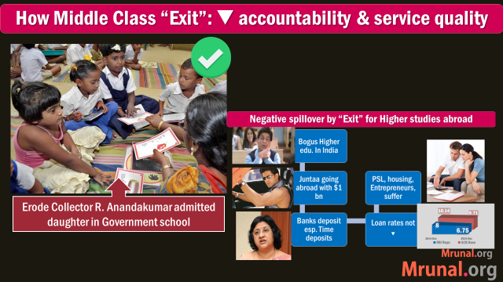
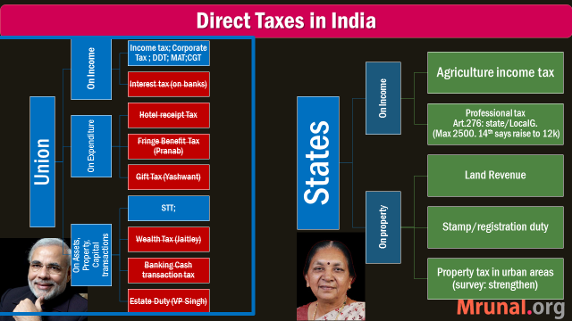
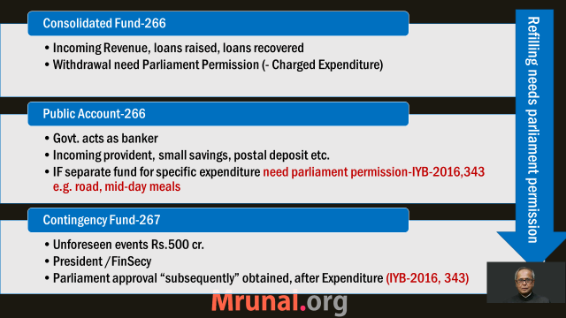

Slide 78
In February 2016
Past Observations (Vol2)
Future Suggestions (Vol1)
To ▲Fiscal capacity
Reduce leakages;
Increase ease of paying taxes
Past Data
Future Plan
1st April 2016
Tax collection & Expenditure
31st March 2017

Slide 79
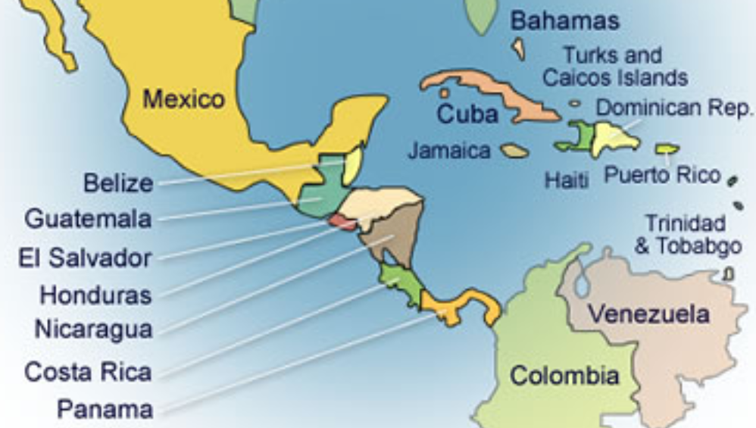
Central America: Panama
Panama Canal
Atlantic to Pacific
Suez Canal
Red sea to Medi.
Notes:
Panama city

Slide 80

Panama Papers?
Mossack Fonseca: Panama law firm
Helped HNIs/MNCs to register cos. in tax havens for round tripping
Panama Papers: anonymous leak to German Newspaper
More: indianexpress.com/topic/panama-papers/

Slide 81
Global Measures
OECD: Base Erosion and Profit Shifting (Beps)
Prevent companies from shifting profit to low-tax jurisdiction nations
OECD: Automatic Exchange of Information (AEOI)
information flows among signatories.
USA: Foreign Account Tax Compliance Act (Fatca)
Countries need to inform US- about investments of American taxpayers/companies

Slide 82
Global Measures
FATF: Financial Action Task Force
to combat money laundering and terrorist financing
Secretariat: Paris, provided by OECD
India
Problems: 157th in ease of paying taxes; Capital Gains tax +dividend distribution + Corp.Tax=~50% profit gone.
Prevention of Money Laundering Act.
General Anti-Avoidance Rule (GAAR) WEF 1/4/2017
Liberalised Remittance Scheme (LRS), every Indian resident is allowed to invest $2,50,000 abroad every year…

Slide 83
Income disclosure scheme for domestic tax payers
Declare undisclosed income between 1st June to 30th Sept. 2016
+ Tax at 30%
+ Krishi Kalyan surcharge at 7.5%
+ Penalty at 7.5%
Total 45% Tax on the undisclosed income.
=immunity from prosecution.
Budget 2016
Surcharge on specific purpose !

Slide 84
Interest on delayed payment of taxes
Before: Interest on delayed payment of Taxes
Customs 18%
After: all three same: 15% interest
If service tax collected but not deposited- 24%
Excise 18%
Service Tax depending on amt. & years 18-30%
▼amt = ▼ litigation
Uniform rates= smoother administration towards GST

Slide 85
Indirect Taxes: reducing litigation
Commissioners
CES-Tax Appellate Tribunal (CESTAT)
High Court
*Can’t file appeals for cases <10 lakh
*Can’t file appeals for cases <15 Lakh
Pay Tax + Interest + 25% of the penalty (except some criminal cases)
Service Tax: prosecution only 2cr./>; arrest only if collected but not deposited
11 new benches
Govt. to withdraw appeals in cases <5 lakh Rs. ongoing for 15 years
Indirect tax Dispute Resolution Scheme, 2016
Similar for Direct taxes
Notes:
Smuggling, nacotics etc.

Slide 86

Direct taxes: 5.5 lakh cr worth cases pending
BEFORE
Penalty: 100-300%; on IT officer’s discretion = corruption chance ▲
50-200%= less litigation
Single member ITAT can hear appeals upto Rs.50 lakhs
AFTER Budget 2016
Already pending case @commissioner level (both direct-indirect):
Above 10 Lakh- 25% of min. possible penalty.
upto Rs.10 lakh- pay interest+tax, no penalty
Notes:
Appellate order >90 days: Government to pay 9% interest, officer to be held responsible.
There are about 3 lakh tax cases pending with the 1 st Appellate Authority with disputed amount
being 5.5 lakh crores. In order to reduce this number, I propose a new Dispute Resolution Scheme (DRS).
A taxpayer who has an appeal pending as of today before the Commissioner (Appeals) can settle his case by paying the disputed tax and interest up to the date of assessment
t. No penalty in respect of Income-tax cases with disputed tax up to `10 lakh will be levied.
Cases with disputed tax exceeding `10 lakh will be subjected to only 25% of the minimum of the imposable penalty for both direct and indirect taxes.
Any pending appeal against a penalty order can also be settled by paying 25% of the minimum of the imposable penalty
Except for criminal offenses.
Certain categories of persons including those who are charged with criminal offences under specific Acts are proposed to be barred from availing this scheme.

Slide 87
Computerization in Tax administration
Use of Technology for creating accountability, reduce human interface and compliance cost
e-assessments in 7-mega cities. No face to face contact.
‘e-Sahyog’: to resolve mismatches in Income-tax returns without requiring taxpayers to attend the Income-tax office.
IT systems for customs bonded warehouse.
Budget 2016

Slide 88
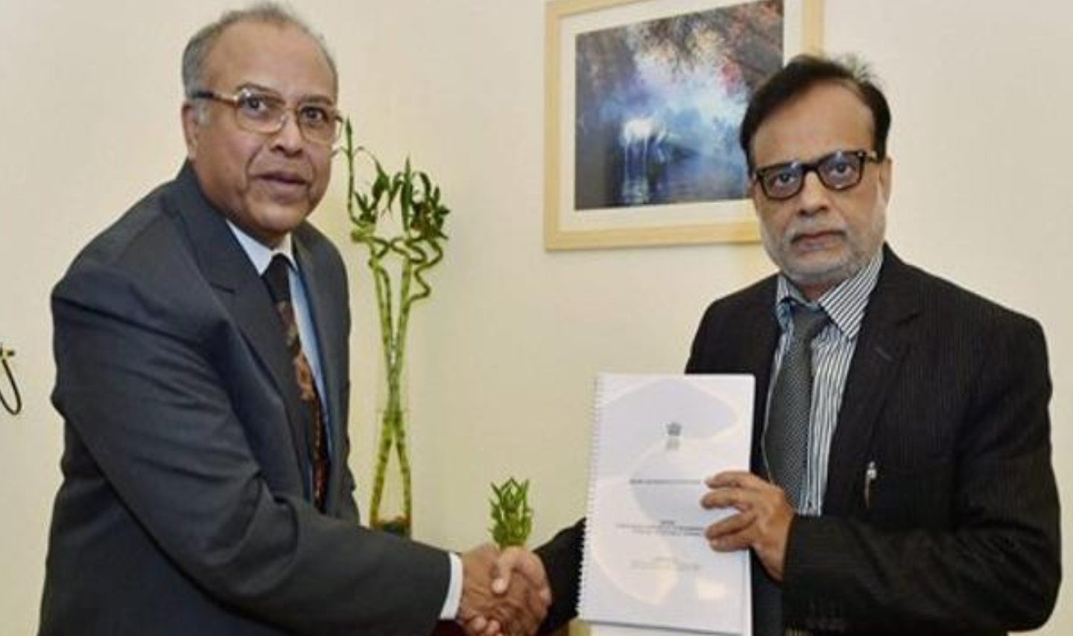
Relief to Desi tax payers
Justice (retired) R.V. Easwar- Expert Committee to simplify income tax laws
Budget 2016 accepted many of them regarding CGT, TDS etc.

Slide 89
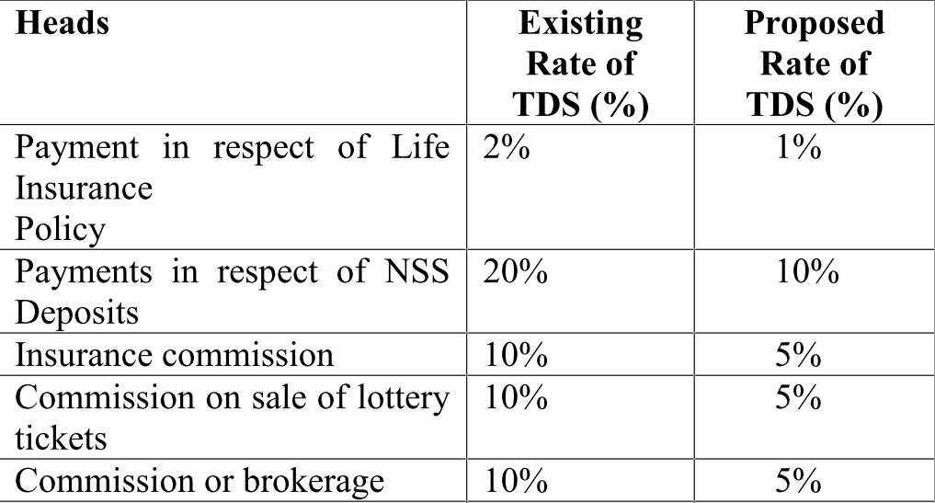
▼ TDS to increase cash flow to small tax payers
Budget 2016
List not exhaustive; Delayed TDS refund=interest to be paid, officer will be held responsible

Slide 90
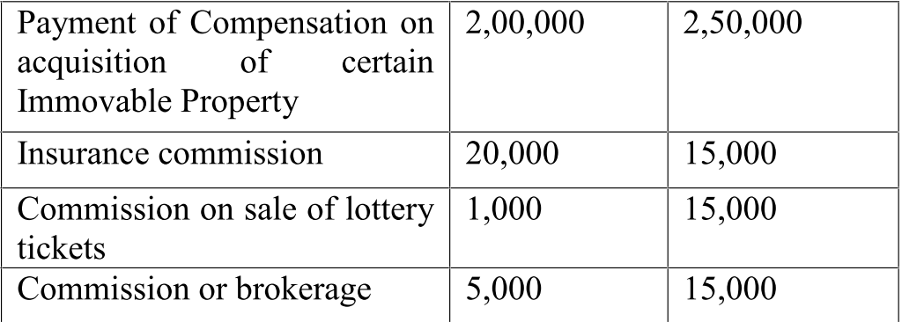
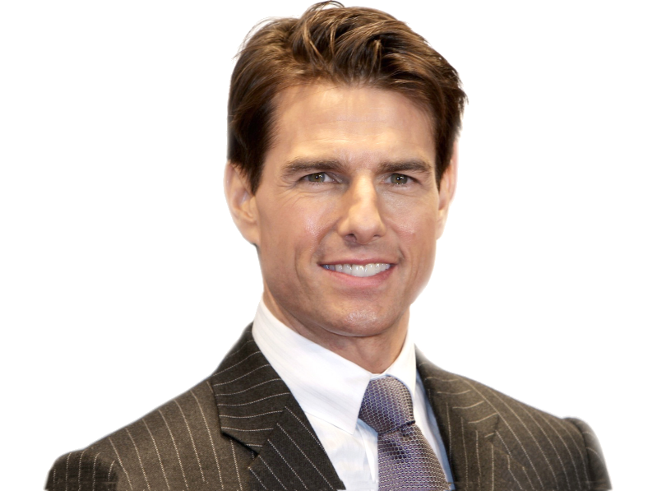
TDS reforms
List not exhaustive
Budget 2016
Before: higher TDS if non-resident has no PAN card.
After: other docx suffice

Slide 91

TODAY: Budget ►Revenue Part
▲Fiscal capacity, why & how?
1 Lakh Cr. Subsidies going to rich, but We can’t JAM-DBT everything because….?
▼Tax avoidance, evasion & litigation. How?

Slide 92
Budget 2016: Relief to foreigners
Retrospective Tax
GAAR
PoEM
Will implement from 1/4/17;
Self-study: “L2/P9”
WEF 1/4/17
Sab kaa Saath, Sab kaa Vikaas ☺
@theHindu…kidhar ho! :-P

Slide 93


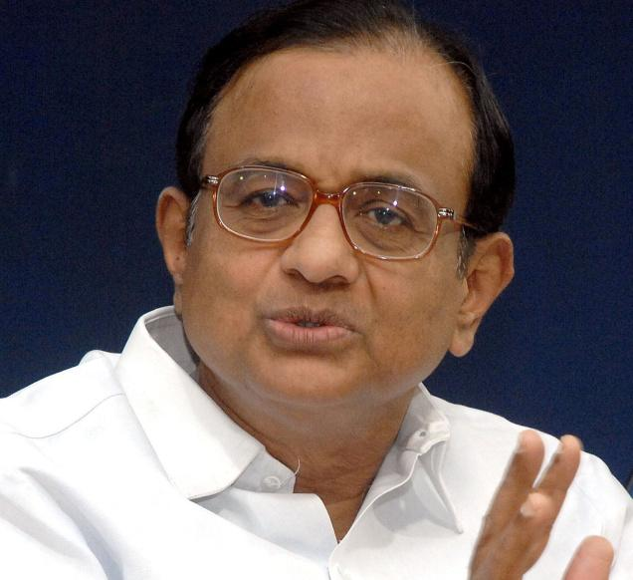
Self-study: “L2/P9”
$ 11 bn
Rs. 55k cr
Hutchinson HongKong
IT act has no provision for CGT on companies outside India
CGT 12k Crore not paid
Retrospective amendment in IT act
GAAR (Shome Panel)
GAAR►1/4/17
Retro- will fix…

Slide 94
Retrospective taxes
“Tax adventurism”: Tax on “Indirect transfers” by applying the retrospective amendment.
Government would not retrospectively create a fresh tax liability.
Revenue Secretary Committee to oversee the implementation of the assurances.
To settle past cases: company should withdrawl app appeals @court,tribunal,BIPA etc.- then pay only the tax arrears. No interest, no penalty.
Notes:
Retrospective taxes
"indirect transfers by applying the retrospective amendment. In order to allay any fears of tax adventurism, this Committee will now be chaired by the Revenue Secretary and consist of Chairman, CBDT and an expert from outside.
This Committee will effectively oversee the implementation of the assurances.
Government would not retrospectively create a fresh tax liability.
In order to give an opportunity to the past cases which are ongoing under the retrospective amendment, I propose a one-time scheme of Dispute Resolution for them, in which, subject to their agreeing to withdraw any pending case lying in any Court or Tribunal or any proceeding for arbitration, mediation etc. under BIPA, they can settle the case by paying only the tax arrears in which case liability of the interest and penalty shall be waived.

Slide 95
PoEM For taxation…
Global company
India can tax only its Indian income.
Indian Resident Company
If Place of Effective Management is India
India can tax both its Indian and global income.
including global passive income e.g. royalty.
If incorporated in India
PoEM not entirely novel, already exists for shipping cos.
Timeline
Finance Act 2015: concept introduced to reduce tax avoidance.
December 2015: Draft guidelines
PoEM starts from 1/4/2017
Notes:
Company will be considered "Indian Resident" IF
Incorporated in India OR
Place of Effective management is in India
Finance Act 2015: concept introduced to reduce tax avoidance.
December 2015: Draft guidelines issued.
Parameters:
Where are management and commercial decision taken?
BoD location? tech. used in their meetings?
if BoD delegated powers to another Executive panel- their location?
From where its royalty, dividend, capital gains, interest or rental income coming? (aka Passive income).
% of total assets and % of total employees located in India.
will be determined on yearly basis.
will be implemented from 1st April 2017 along with GAAR. to help corporates prepare accounts accordingly. otherwise chaos in TDS and advance tax payments.
GAAR
if tax benefit >3cr.
The draft guidelines also state that "the place of effective management in case of a company engaged in active business outside India shall be presumed to be outside India if the majority meetings of the board of directors of the company are held outside India."

Slide 96
parameters
POEM
Where are management and commercial decision taken?
BoD location? tech. used in their meetings?
if BoD delegated powers to another Executive panel- their location?
From where its royalty, dividend, capital gains, interest or rental income coming? (aka Passive income).
% of total assets and % of total employees located in India.
WEF from 1st April 2017 along with GAAR.
Delayed to help companies ready accounts. Else chaos in TDS, advance tax.

Slide 97
Intl. Finance Center (IFC)
Following benefits with caveats
No dividend distribution tax
MAT @9%
Shares in foreign currency: no STT, no DDT, no CGT*
*Depending on long term/short term/ public Ltd/private ltd
Commodity derivatives: no commodity transaction Tax
Budget 2016

Slide 98
Budget 2016: Relief to foreigners
Retrospective Tax
GAAR
PoEM
Will implement from 1/4/17;
Self-study: “L2/P9”
Sabka Saath, Sabkaa Vikaas ☺

Slide 99

Budget ► Revenue► Tax► INDIRECT

Slide 100
TODAY: Budget ►Revenue Part
▲Fiscal capacity, why & how?
▼Tax avoidance, evasion & litigation. How?
1 Lakh Cr. Subsidies going to rich, but We can’t JAM-DBT everything because….?

Slide 101
Budget -2016 ► Revenue Receipt ► Tax ►Direct Tax
Indirect Taxes
Taxes on income other than Corporation Tax

Slide 102
Budget 2015 vs. 2016: Revenue-Estimates (cr.)
Tax benefit
Make in India

Slide 103
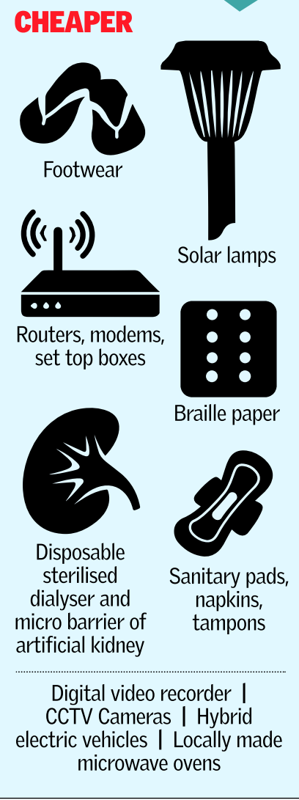
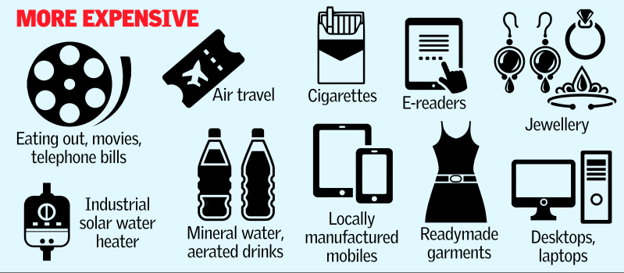
Budget 2016 ► Revenue Receipts ► Indirect Taxes
Specific points under “sectors of economy”

Slide 104

Excise & Customs to boost Make in India?
Custom (import)
▼ raw material
Excise
▲ luxury goods, harmful items
▲ Finished goods
▼ intermediate goods
Custom (export)
▲ raw material
▼ finished goods
▼ environmental
▼ renewable energy
Aerated drinks: 21%
Tobacco: 19-64-81%
Specific points under “sectors of economy”
Notes:
Customs and excise duty structure plays an important role in incentivizing domestic value addition towards Make in India campaig
to make suitable changes in customs and excise duty rates on certain inputs, raw materials, intermediaries and components and certain other goods and simplify procedures

Slide 105
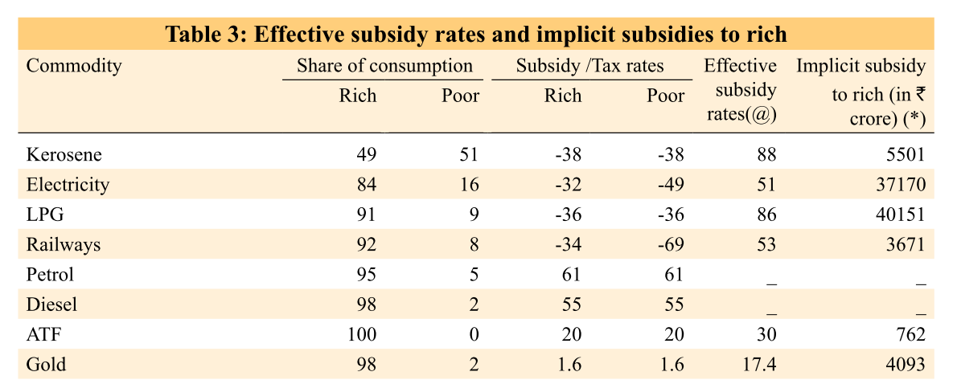
Economic survey: Gold: Demerit Good
Consumer goods
Gold
0% Central Excise
12.5% Central excise
Top 20% population buying 80% of gold
Notes:
In economics, a demerit good is a good or service whose consumption is considered unhealthy, degrading, or otherwise socially undesirable due to the perceived negative effects on the consumers themselves. It is over-consumed if left to market forces.
. Examples of demerit goods include tobacco, alcoholic beverages, recreational drugs, gambling, junk food and prostitution.

Slide 106
1% excise on Gold justification
Central excise duty on non-silver jewelry: 1% (Without credit), 12.5% (with credit)
Jewelers gone on strike
Most states charge 1% VAT;
imitation jeweler attracts 6%;
movement towards GST
Budget 2016

Slide 107
1% excise on Gold justification
Only high-income groups affected, applies Only to big jewelry houses with clearance above Rs.6 cr.in a year (provided last year clearances were less than 12 cr.).
Online registration, no physical verification, no stock verification, chartered accountant certificate sufficient.
Ashok Lahiri Committee (Ex-Chief eco.advisor) too look into demands.
April 2016: Jewelers finally called off strike after government assurance they'll not be harassed by excise inspectors.
Budget 2016

Slide 108
1% TCS on Purchase (To be administered under CBEC)
Tax collection on source
Expensive cars > 10 lakh
Cash payment >2 lakh for goods/services.
Seller will have to collect
Revenue $+data of people who buy expensive things, but missing tax base.
NA on farmers and other selected categories.

Slide 109

Which of the following will increase tax base of India?
Budget 2015
1% TCS @purchase of luxury cars.
Addl. 10% tax on shareholders, if they’re earning >10lakh in dividend.
raising income tax slabs
Choices:
A): Only 1 and 2; B): Only 2 and 3;
C): Only 1 and 3; D): All of them

Slide 110
Abolition
Government to abolish 33 Cess levied by other ministry / Department
Administered by Department of Revenue
where <50cr. Collected in each
CESS
Notes:
E.g cess on textile machinery (60 lakh); Mica (2 cr); lime-stone (16) cr.
Not sure if these are administrated by other departments??

Slide 111

EXCISE
CESS
Infrastructure cess on vehicles; shall not be shared with states
1% on small petrol, LPG, CNG cars upto 1200cc
2.5% on diesel cars upto 1500cc
4% on other higher engine capacity vehicles and SUVs.
N/A on public transport, ambulance, PH-vehicles, e-cars, hydrogen fuel cars

Slide 112

EXCISE
CESS
Clean Energy Environment Cess (renamed)
Coal, lignite and peat
Per Tonne: Rs. 200 400/-

Slide 113
SERVICE TAX
Swachh Bharat Cess: 0.5% on Value of services, WEF 15/Nov/2015 (no input credit)
Krishi Kalyan Cess: 0.5% WEF 1/June/2016 (with input credit)….Ref GST lecture to understand “input credit”
CESS
Notes:
*Krishi Kalyan Cess
@ 0.5% on all taxable services WEF 1/June/16
Financing initiatives relating to improvement of agriculture and welfare of farmers
Cess
I propose to abolish 13 cesses, levied by various Ministries in which revenue collection is less than `50 crore in a year.
Infrastructure Cess - pollution /traffic
1% on small petrol, LPG, CNG cars
2.5% on diesel cars of certain capacity
4% on other higher engine capacity vehicles and SUVs.
Clean Energy Cess
I propose to rename the ‘Clean Energy Cess’ levied on coal, lignite and peat as ‘Clean Environment Cess’ and simultaneously increase its rate from `200 per tonne to `400 per tonne.

Slide 114
Before Budget-2015
For now
Value of Service: Rs.100
Service tax: Rs.12
3% Edu. cess on ST: Rs.0.36
Final: Rs.112.36/-
Effective Service Tax: 12.36%
Value of Service: Rs.100
Service tax: Rs.14
0.5% Swatchh B. cess on Value of service: Rs.0.50
Final: Rs.114.50/-
When KKC comes…another 0.5%
Effective Service Tax: 15%

Slide 115
Budget -2016 ► Revenue Receipt ► Tax ►Direct Tax
Incl.
51k surcharge
14k. Edu cess
Incl.
7k+ surcharge
9k+ Edu cess
Incl.
3k infra cess
26k clean envi.
Incl.
10k SBC
5k KKC

Slide 116


Service tax doesn’t apply to….
Negative List (Statutory)
17 categories
RBI service, Post Office service, Foreign diplomatic service in India
Education Service but not tuition…… and so on
Exempted (Gazette)
PM Suraksha Bima; PM Jeevan Jyoti; PM Jan Dhan
Atal Pension
*DD Gramin Kaushlya Yojana; assessing bodies
*Niramaya: health insurance for autism,palsy,retard,multi-disability
- AC state public buses
Removed mutual funds and lottery, monorail-metro,
Notes:
Mutual fund
?
exempt service tax on services provided under Deen Dayal Upadhyay Grameen Kaushalya Yojana and services provided by Assessing Bodies empanelled by Ministry of Skill Development & Entrepreneurship.
exempt service tax on general insurance services provided under ‘Niramaya’ Health Insurance Scheme launched by National Trust for the Welfare of Persons with Autism, Cerebral Palsy, Mental Retardation and Multiple Disability.

Slide 117

Rs.75 cr Service tax demand on SEBI
CBEC
Sebi earns revenues from initial public offers, new fund offers and registration fees of brokers.
Finance bill 2012: negative list concept. SEBI neither negative nor exempted.
SEBI
Sebi Act: Board, shall not be liable to pay tax on its wealth, asset, income, profit.
Budget 2016: regulators exempt but WEF 1/4/2016.
So, pay service tax for 2012-2015

Slide 118



Gross Tax Revenue एकंदर महेसुल आवक 16.3L Cr.
Direct
Taxes
8.5Lcr
Indirect
Taxes
7.8Lcr
UT w/o
Legi.
4k cr
MINUS
NCCF under MHA (Public Account)
6450 Cr.
States’ share
5.7L cr.
NET Tax Revenue : चोख्खी महेसुल आवक: 10.5L cr.
Notes:
Ekandar mehsul awak
Sakal rajaswa aay
Less - NCCD transferred to the National Calamity Contigency Fund/National Disaster Response Fund

Slide 119

Revenue: Non-Tax

Slide 120
TODAY: Budget ►Revenue Part
▲Fiscal capacity, why & how?
▼Tax avoidance, evasion & litigation. How?
1 Lakh Cr. Subsidies going to rich, but We can’t JAM-DBT everything because….?

Slide 121
Sources of non-tax revenue
Decreasing order
Profit Interest Dividend received
Services
Economic Services
General, Police & Defense Services
Social Services
Fiscal services (least among all non-tax)
Grants received
Dividend & Profit
Interest
~9k from railways
~8k from States
Decreasing order
Decreasing order

Slide 122

Non Tax Revenue
Railway dividend decided by Railway convention Committee ; @present its 4%

Slide 123


Non Tax Revenue (conti.)
Spectrum sale
Railways Revenue

Slide 124
Survey 2015
Which of the following are sources of non-tax revenue for Government of India?
Dividend from RBI
Spectrum auction in telecom sector.
Royalty from offshore oil field
Answer choices
A): Only 1 and 2; B): Only 2 and 3;
C): Only 1 and 3; D): All of them

Slide 125

1949: Nationalization, RBI fully owned by GoI
Main Sources of Income
Interest on G-sec, foreign T-Bonds
Repo, Lending Ops.
India’s Forex Reserve consists of
Foreign Currency (mostly in foreign sovereign bonds)
Gold 3) SDR 4) Reverse Transche
RBI has paid higher dividend to Government during Rajan’s “Raj”

Slide 126
Survey 2015
Which of the following are sources of non-tax revenue for Government of India?
Dividend from RBI
Spectrum auction in telecom sector.
Royalty from offshore oil field
Answer choices
A): Only 1 and 2; B): Only 2 and 3;
C): Only 1 and 3; D): All of them

Slide 127
TODAY: Budget ►Revenue Part
NEXT
▲Fiscal capacity, why & how?
▼Tax avoidance, evasion & litigation. How?
1 Lakh Cr. Subsidies going to rich, but We can’t JAM-DBT everything because….?

Slide 128

For best results..
Self study After Today’s Lecture
V1C7- fiscal capacity
Before next lecture ;
Finance “L2”
Budget “L4” + GST, 14th FC
youtube.com/user/TheMrunalPatel
+ Daily English newspaper: Hindu (1st Preference) OR Indianexpress

